Slide 1
Empathy

Slide 2
Definitions
Empathy is the ability to emotionally understand what other people feel, see things from their point of view, and imagine yourself in their place. Essentially, it is putting yourself in someone else's position and feeling what they are feeling. – verywellmind.com
"the action of understanding, being aware of, being sensitive to, and vicariously experiencing the feelings, thoughts, and experience of another.“ - Merriam-Webster

Slide 3
Statistics on Empathy
Empathy is #1 rule for “new product innovation success” according to a Nielsen analysis of 61,000 SKUs representing more than 12,000 new launches since 2011. 3 in 4 FMCG launches fail within a year. Those that succeed focus on “walking in the shoes of the consumer to uncover key demand-driven insights”.
Empathy boosts business creativity. In a scientific experiment with 209 adults, a simple empathy exercise designed to activate empathy boosted the creativity of participants who were innovating a new line of new potato chips for pregnant women. Before beginning, some participants were asked to imagine how a consumer would feel using the product (empathy-inducing condition), whilst others were asked to imagine what the consumer would think when using the product (objective-imagination control condition). An independent jury found the ideas of the empathy-activated group were more original than the control group. Four other experiments confirmed the finding; whether it’s designing new toys, cereals or shopping carts, activating empathy boosts creativity. These experiments also showed that empathy can boost creativity by increasing our ‘cognitive flexibility’ (ability to see from and switch between multiple perspectives). This study confirmed previous findings that empathy is linked creativity (and inversely related to dogmatism)

Slide 4
Statistics on Empathy
Empathy improves satisfaction. A Korean study in the healthcare sector found that empathy improves patient satisfaction and compliance (adhering to treatment schedule). Five hundred and fifty outpatients participated in the study. Physician empathy levels were linked to better information exchange, perceived expertise, interpersonal trust, and partnership. This resulted in higher patient satisfaction and better compliance.
Empathy improves ability to negotiate. It might seem self-evident that the ability to see things from the other side of a negotiating table is beneficial in negotiations, but an INSEAD experiment by Adam Galinsky and colleagues validated this scientifically. 146 negotiators were profiled for the empathic ability of perspective-taking, and this was found to predict negotiation success. Across three negotiations, empathic perspective-taking was linked to negotiators’ ability to discover hidden agreements, to both create and claim resources at the negotiation table.

Slide 5
Statistics on Empathy
Empathy is linked to good leadership. In studies by the Management Research Group, empathy was found to be the top competence for good leadership and one of the three strongest predictors of senior executive effectiveness. Similar results were found by 2016 CCL analysis of 6,731 leaders from 38 countries, where enhanced empathy was linked to superior performance. A recent DDI analysis of high performing leadership with 15,000 business leaders confirmed the same link between empathy and leadership performance. More worrying was the finding that empathy remains low in business leaders, with only 40% having proficient empathy skills.
The empathy delusion in marketing. Marketing involves consumer closeness and understanding. But a 2019 study called The Empathy Delusion conducted by Reach found that marketers have no elevated ability to understand and empathise with consumers. 199 marketing executives completed an empathy psychometric test (the IRI – Interpersonal Reactivity Index) measuring their empathy levels both cognitively and emotionally. The study found no differences between marketers and the general population. Only 30% of marketers were proficient in experiencing the world from someone else’s (i.e. the consumer’s) perspective.

Slide 6
Statistics on Empathy
The empathy deficit in business costs the average brand over $300m in lost revenue every year. This is the finding of a large-scale 2018 study by M&C Saatchi with 34,000 consumers across 225 large brands in China, US, UK and France. The study looked at people’s actual real-lived experience of brands, and whether it matched marketing promises made by the brand. They then assessed the consequences of any mismatch. The study found that 18% of consumers had stopped using a brand in the last 12 months because of the gap between marketing and experience, with 32% believe the gap is widening. Overall, this gap represents a fundamental empathy deficit among brands who are out of touch with what it feels like to use the brand.
The empathy deficit and the 80:8 rule. Bain management consultants have identified a persistent empathy deficit in business characterised by the 80:8 rule. Across nearly 400 organisations. 80% of firms believed they deliver a superior experience to customers, whilst only 8% of their customers agreed.
A lack of consumer-centricity costs brands 69 points in NPS (experience rating). In a 2017 global survey by Capgemini, 75% of brands audited believed they were consumer-centric, but only 30% of their consumers agreed. The study also found that brands perceived as not consumer-centric has an NPS experience rating 69 points lower than consumer-centric brands.

Slide 7
Statistics on Empathy
Empathy levels may be falling. Our ability to empathise with others may be falling according a meta-analysis of US citizen empathy test scores conducted over the past 30 years. The study found that average American today is less empathic than 75% of Americans 30 years ago.
Women are (usually) more empathic. Although empathy is an ability that can be improved with training, psychometric test norms tend to show that women typically have higher natural levels of empathy than men. For example, the 60-question EQ test measures ‘Empathy Quotient’ on a 0-80 scale with 80 being the most empathic possible. In a UK validation of the EQ with 1716 participants, women were found to have an average EQ of 48/80 (60%), and men 39/80 (49%), indicating that women are 11% more empathic than men. A shorter test EQ-Short found women scored 26/44 (59%) and men 20/44 (45%), indicating a similar discrepancy. An alternative empathy test (the TEQ – Toronto Empathy Questionnaire) also shows women can score more highly. Finally, women tend to outperform meant on a popular empathy test called the ‘Eyes Test’ (the full name is ‘Reading the Mind in the Eyes’) which tests people empathic ability to read emotions in peoples eyes. For example, in one recent validation of this test, women could correctly read 76% of emotions expressed through eyes, men 71%).

Slide 8
Statistics on Empathy
Empathy is (partly) genetically determined. Like other personality traits, empathy is an ability that appears to be partly genetically determined. A study comparing empathy differences between twins and siblings found 52-57% of emotional empathy is due to genetics, compared to only 27% for cognitive empathy. Using the Empathy Eyes Test as a behavioural measure of cognitive empathy, and cross referencing this with the genetic profile of 88,056 23andMe customers, Cambridge University researchers have found an association between cognitive empathy in females and a genetic variation on chromosome 3 (3p26.1). A followup study using the EQ scale found that only about 10% of variation in overall empathy (emotional and cognitive) appears to be due to genetics. The study also found that women are on average more empathic than men, scoring an average of 50 (63%) vs 42 (53%) for men.
Empathy develops over time. Less business focused but interesting nonetheless. Empathy grows with cognitive development. For example, children under four typically fail simple tests assessing their ability to understand something from someone else’s perspective (cognitive empathy). At four and above, children begin to pass these tests (e.g. the Sally-Anne test), indicating normal cognitive development (although sufferers from autism have difficulty with perspective-taking). Jean Piaget demonstrated this with the ‘Three Mountains Test‘ that involves matching photos taken from vantage points on a model of three mountains to the vantage points from which they were taken. At the age of four, children cannot de-centre their view, and typically fail this test. But by the age of 7 or 8 they usually pass, indicating normal cognitive development from egocentric thinking to acquiring a perspective-taking ability.

Slide 9
Facts on Empathy
Empathy Contributes to Positive Outcomes - Forbes
But as we go through tough times, struggle with burnout or find it challenging to find happiness at work, empathy can be a powerful antidote and contribute to positive experiences for individuals and teams. A new study of 889 employees by Catalyst found empathy has some significant constructive effects:
Innovation. When people reported their leaders were empathetic, they were more likely to report they were able to be innovative—61% of employees compared to only 13% of employees with less empathetic leaders.
Engagement. 76% of people who experienced empathy from their leaders reported they were engaged compared with only 32% who experienced less empathy.
Retention. 57% of white women and 62% of women of color said they were unlikely to think of leaving their companies when they felt their life circumstances were respected and valued by their companies. However, when they didn’t feel that level of value or respect for their life circumstances, only 14% and 30% of white women and women of color respectively said they were unlikely to consider leaving.
Inclusivity. 50% of people with empathetic leaders reported their workplace was inclusive, compared with only 17% of those with less empathetic leadership.
Work-Life. When people felt their leaders were more empathetic, 86% reported they are able to navigate the demands of their work and life—successfully juggling their personal, family and work obligations. This is compared with 60% of those who perceived less empathy.

Slide 10
A Guide to Empathy in Customer Service
“I’m constantly blown away at how appreciative people are when they get human replies. Years of uncaring or even hostile support experiences have set the bar low for their expectations that they get excited by genuine answers.”
–Micah Bennett, Zapier
What is the one skill that everybody in customer support must have?
Ask this to anybody who’s been in customer service for a while and ‘empathy’ would be high up on the list. We’ve put together a short guide on the importance of empathy in customer service and tips to empathize with customers better. You can use the following links to navigate through the blog.
– Why is empathy important in customer service?
– Identifying an empathy problem
– How to build empathy?
– How do you empathize with a customer?
– Expressing empathy as a company
What is empathy in customer service?
Empathy is the ability to understand and share the feelings of another. It is the act of putting yourself in someone else’s situation and seeing a problem from their point of view.
In customer service, empathy is the ability to have a human interaction with a customer where you would intentionally put yourself in the customer’s shoes to understand their issue and find the best possible solution for your customers. Let’s look at an example of empathy in customer service for a better understanding.

Slide 11



Slide 12
Example of empathy in customer service
The above tweet has some powerful phrases that reveal empathy towards the customer (a.k.a empathy statements – we’ll get to that in a bit). The highlighted phrases in Slack’s reply indicate that the company has truly heard the customer and taken action on their query, rather than a robotic ‘thanks for your feedback’ type of reply. That’s empathetic support in action.
If you take a look at some of the spectacular customer service failures, you will see that they involve a (maddening) lack of empathy.
Being empathetic towards someone doesn’t mean that you agree with them. It just means that you understand their truth. It is an important character trait for support agents to have because they have to talk to many different kinds of customers every day, solve their problems, all the while making sure that they are representing the company in the best way possible for an excellent customer experience.

Slide 13
Why is empathy important in customer service?
You may wonder why it is important to spend time and effort empathizing with a single customer when you can use that time to efficiently solve multiple customer issues.
There are many benefits to expressing empathy apart from improving the customer experience and moving the bottom line, which is ‘making customers happy’.
1. A better understanding of people
Customer support is all about people. If you understand people better and know how your customer feels, you can support them better. And practicing empathy every day will help you do that. The pandemic has further stressed the importance of understanding people better and empathizing with them. Our research shows that 52% of consumers stopped buying from a company due to their communication, with 17% of them quoting ‘insensitivity’ in engagement as the primary reason. Challenging times faced by customers and customer service agents getting the hang of remote support have made the importance of empathetic support even more prominent.
2. Noticing things that are unsaid
Customer needs and feelings aren’t always spelled. Based on their situation, body language, voice, tone, and even website behavior like rage clicks, you will be able to guess what motivated them to approach you, their unspoken pain points, what is at stake for them, and how they are feeling.
3. Dealing easily with conflicts
When you understand what is unsaid, you can address it and make customers feel heard – which is the first step towards resolving conflicts. Empathetic support can even turn angry customers into more patient and cooperative, collaborative problem solvers.
4. Building stronger customer relationships
Showing empathy in customer service conversations triggers emotional bonds with your customers. Research by HBR indicates that emotional connections have a huge impact on human decision-making and purchase behavior. Empathy creates stronger ties with customers that lead to repeat purchases and increase customer loyalty.

Slide 14
5. Invoking empathy from customers
There are a lot of hard conversations in customer support. Saying no to customers or telling them that they need to pay more to use a feature is hard enough. In such cases, a lack of empathy will make the customer mistrust your intentions. But when you are able to understand their motivation and point of view, it gets much easier to gain their trust and convince them of the value of your offering.
6. Predicting action and reaction
You will be able to predict a customer’s follow-up questions and proactively answer them. You will be able to predict what they will feel when they read your answer. You will also be able to understand what is holding them back from implementing an alternate solution. Knowing these things will make the conversation much easier. Empathizing and predicting customers’ next steps also helps you design effective service journeys and chatbot implementations.

Slide 15
Identifying an empathy problem
As a consumer, you might have noticed that some customer service interactions make you feel happy even when you don’t end up getting what you wanted. Chances are, you were lucky enough to talk to a particularly empathetic customer service team or rep.
But those instances are rare. A lot of individual customer service agents, teams, and even organizations suffer from a lack of empathy. Some classic signs are:
Tone mismatch between the agent and the customer – One of them is too formal and the other too informal.
Late responses are sent without apologies.
Customers being discouraged from contacting support, through words and behavior.
Agents with the Somebody Else’s Problem syndrome – That is, issues getting deflected to other departments without any explanations or follow-ups.
Lack of customer satisfaction – There is no bigger sign of lack of empathy than the customer being unhappy even after getting what they want.
If you notice any of the above signs in your team’s interactions with customers, you might have an empathy problem.
Not everybody is lucky enough to be born with a capacity for endless empathy. But the good news is, empathy, like any other skill, can be learned.

Slide 16
How to build empathy?
Everybody has a degree of empathy and anybody can develop and cultivate their empathy using the following ways.
– Understand your biases
We instinctively make judgments based on language, color, gender, religion, accent, and vocabulary. We do not notice when we are acting out of bias but it makes us treat some customers differently than others.
For example, assuming that a customer would not be tech-savvy because they are older and blaming them for the issue they are facing is because of our bias. This bias creates a barrier between agents and customers.
To cultivate empathy, you need to recognize your biases. Every time you assume something about someone when there is no data to support it, contemplate and find out if that was because of a bias.

Slide 17
– Reading fiction and other activities to put you in someone else’s shoes
Reading fiction is a proven technique to build empathy. If you are not a big reader, meeting different kinds of people will also help cultivate empathy. You can start small by having a goal of meeting one new person every day. Each person will give you a different perspective and open up your world a little bit more.
Other activities that are generally said to increase empathy are volunteering, doing role-playing games, or even taking acting classes where you are quite literally walking in someone else’s shoes.
– Maintain positivity
Being empathetic to the first customer of the day is easy. But to treat the last customer in the same way you treated the first customer, you need to remain positive and motivated.
A good way to stay positive is by observing yourself for a week and noting down the times you feel a positive or negative emotion and the events that trigger it. This will give you a clear idea of what activities to avoid when you have to remain positive to get through the day.

Slide 18
– Understand your customer base
When you don’t understand where the customer is coming from, it’s easy to think that they are overreacting to a simple problem. It’s hard to mask those thoughts and act as if you are empathetic. To cross that barrier, you need to figure out who your customers are and what your product or service means to them. In the context of their educational background, age, company, organization structure, etc, you can really bridge the gap and cultivate empathy.
– Get feedback from your peers and customers
Sometimes, it’s very hard to objectively look at the way you deal with customers. So at the end of a conversation, you can ask your customers open-ended questions like “What do you think would have made this conversation better?”. If your customers complain about not being heard or respected, then you know that it is an empathy problem.
Similarly, you can ask a peer who gets along well with customers for their opinion on the way you talk to them. The important thing to remember here is to receive the feedback with an open mind.

Slide 19
– Teach
Another good way to cultivate empathy is by teaching. Whether it’s just teaching your kid how to swim or a friend how to juggle, teaching requires a lot of patience and practice. If you get an opportunity to teach someone about the product or service you support to your new colleague, take it up immediately. You will be able to see what new customers struggle with. You will see how each person understands things differently. This will help in viewing situations from a customer’s perspective and increase your ability to empathize with a customer.

Slide 20
How do you empathize with a customer?
Expressing empathy is as important as cultivating it and helps you deliver great customer service. Customers need to know that you do understand how they feel through words, tone of voice, body language, and other cues depending on how the conversation is happening. Here are some ways in which you can empathize with a customer.
#1 Active listening
Let your customers talk and actively listen to what they are saying. Do not jump to conclusions. Do not offer a solution before they can finish telling you about the problem. Let them finish talking and respond with the same words they used. Sometimes customers want to vent. Half of their issue will be solved once a customer’s concern feels heard.
#2 Avoid sympathy
Whether it’s a mail or tweet you are writing to your customers or a support call that you are handling, switch from mere sympathy to using more empathetic statements in your interactions. Instead of saying “That must be frustrating”, try saying “I understand how frustrating that is.” Being more personal also helps. Instead of saying “The team will resolve this issue soon”, try saying “I am working with the team to solve this issue soon”. Using empathy statements like these will go a long way in making the customer feel valued.

Slide 21
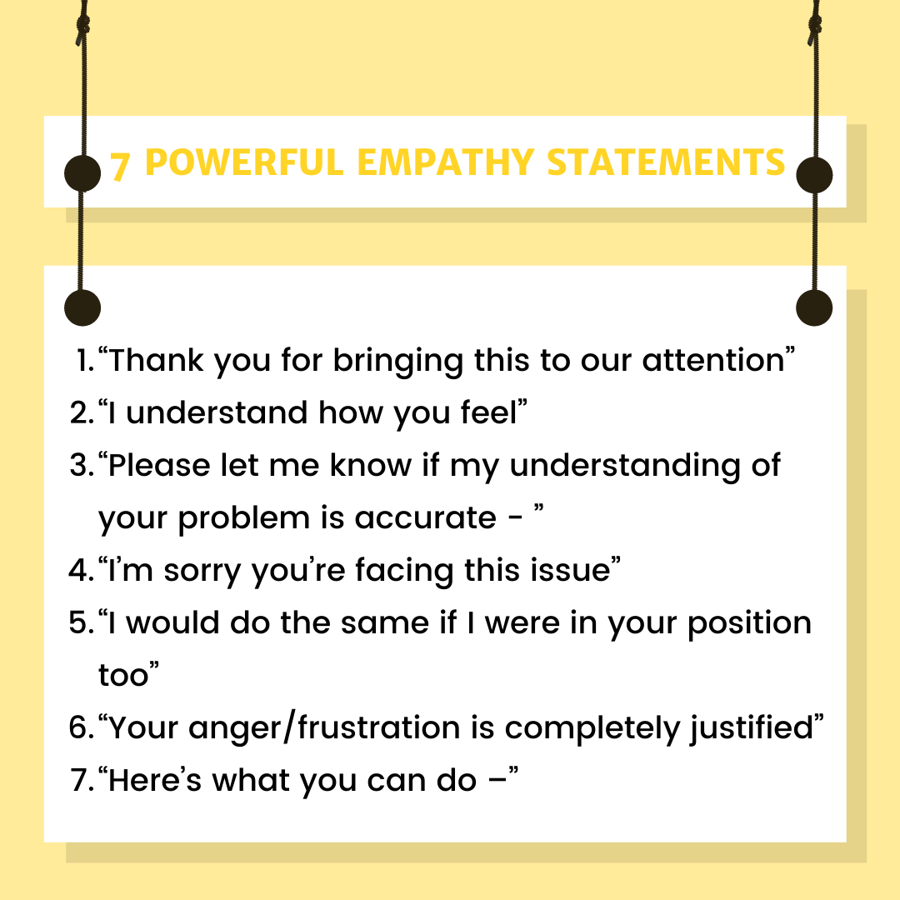

Slide 22
#3 Keep your attitude in check
Your job is not to be right. Your job is to help the customer. Whenever you have the urge to blame a customer for their mistake, take the high road without expecting their apology. This is not to say that you should let them walk all over you. You can be empathetic and stand your ground when you deal with abusive or difficult customers.
#4 Give people the benefit of doubt
If it feels like the customer is overreacting to something, understand that it’s not personal. Maybe they are having a bad day, maybe their job depends on this issue, maybe they have a personal problem. You might not be able to pinpoint what’s bothering them but give them the benefit of the doubt. Always work under the assumption that this interaction is going to make their day better. Actively practice giving second chances.
#5 Make customers a part of the solution
There are times you think the customer is being unreasonable. Your product or service might not have been built to solve that customer’s problem but they might be expecting it. In such cases, ask them what they think the right solution is. This will give them a chance to put themselves in your shoes instead of being against you.

Slide 23
#6 Be curious about your customer
Customers hate being treated like they have been figured out when they never had a chance to explain. Expressing curiosity about what the customer is doing and how they came to face that particular problem will go a long way. Once they go from being on the offensive to revealing helpful information, they become much easier to talk to.
#7 Look for common interests
Take some effort to build a bond with customers. Did you notice that their desktop image is that of your favorite band? Bring it up in your conversation. Both you and your customer will find that you can understand each other better when you have more in common than you thought.
#8 Always be respectful
Always greet the customer with their name. It’s easy to forget manners when the conversation is taking a bad turn and has been going on for a long time. Even as you are standing up for yourself, remember to not put them down.

Slide 24
.
Related resource: 10 Tips To Improve Customer Service Communication
#9 Be extra careful when there is a language barrier
You can always assume that when you are talking to someone who comes from a different culture or country, some things will be lost in translation. So be extra careful in those situations, and try to make yourself as clear as possible. You can even use emojis to express your real emotion if it comes down to it.
#10 Respond to the customer’s tone
Replying to a customer’s excited email with a formal boilerplate is the worst thing you can do. So always respond to the customer’s tone. You don’t have to give up your own or your company’s personality in the process. Just have a formal-informal scale that you are comfortable with and pick a tone that’s between that scale.
#11 Do not assume, ask
Do not assume that customers would not know the simplest solution. Don’t tell them to refresh their screens or reboot their phones assuming they would not have done it. Always ask them if they have already done that and show that you are willing to troubleshoot further. If you assume, not only will the resolution be delayed, the customer will also feel like they are being rushed.
#12 Take their side when they are right
Don’t be afraid to take their side. When they are right and the fault is on your company’s side, go ahead and say “You’re right. We messed up.” Customers will respect you and your company for it. They will understand that you truly value your customers’ opinions.

